Slide 1
06. Med-fi Prototype & Design Choices
Team Mango
May 10, 2023
CS 337E: Design for Global Grand Challenges

Slide 2

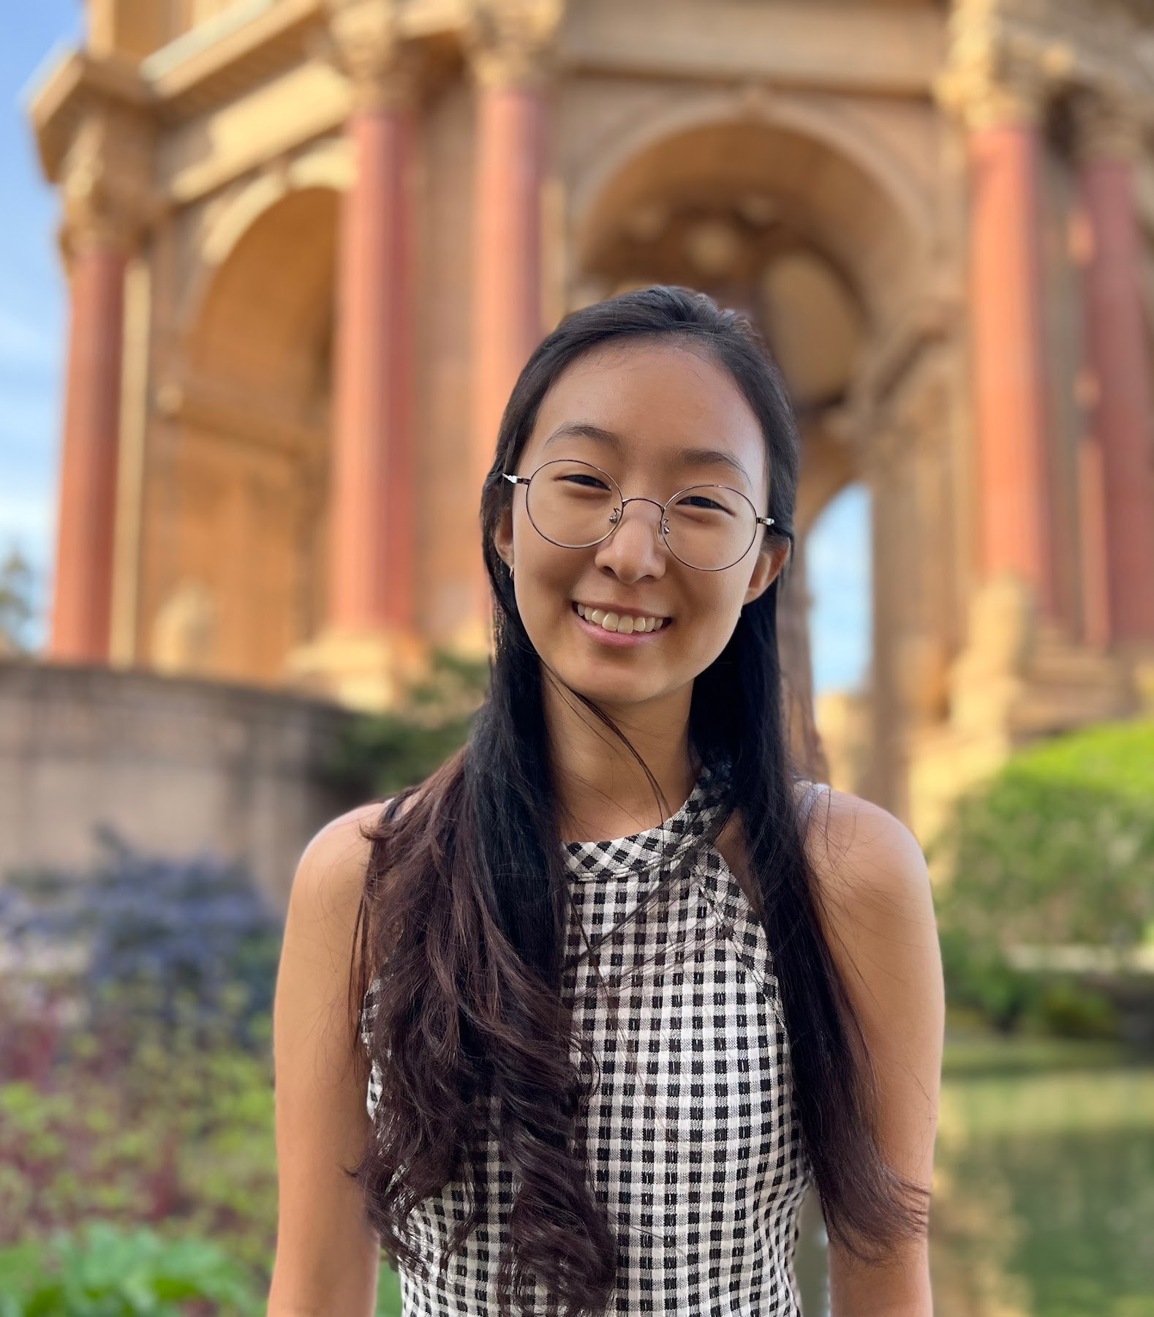

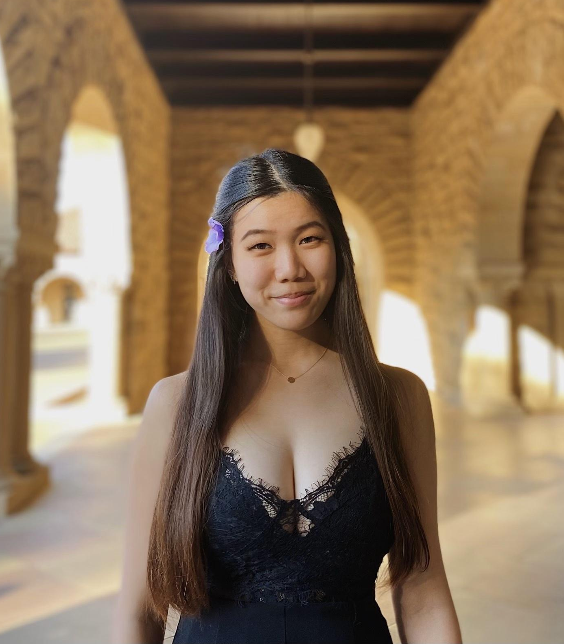
Team Mango
Homeschool Education
Nathan M.
Christina K.
Claire M.
Grace Z.
CS, AI Coterm
Econ, HCI Coterm
CS, HCI Coterm
CS, HCI Coterm

Slide 3
Problem Space
&
Solution

Slide 4
Problem Space + Solution Overview
All students deserve access to a quality education.
Not all homeschooling parents have the resources or experience to provide such an education, leading to unequal outcomes during schooling and later in life.
We want to level the playing field and provide resources for homeschooling parents to be better equipped and more empowered in their teaching, for their kids.

Slide 5
Mission Statement
Value Proposition

Slide 6

Mission Statement
Our mission is to empower and equip parents as they seek to create engaging and inspiring learning environments at home.

Slide 7

Value Proposition
Personalized Feedback Solutions:
Live lesson tracking and generated reports to help parents tailor feedback strategies to their child's individual needs
Actionable insights and recommendations
Empowerment and Confidence:
Through insights on live lessons and simulations, gain experience and confidence in teaching

Slide 8
3 Tasks

Slide 9



Low-fi Tasks
Simple
Moderate
Complex
Sign-up and find the “Tip of the Day”
Record a live lesson and view generated feedback
Participate in teaching and feedback simulation

Slide 10

Low-fi Tasks
Feedback: Practice isn’t the best use of time
“in terms of parent wanting to use time most efficiently, want to get certain amount of teaching done today” – P2
Simple
Moderate
Complex
Sign-up and find the “Tip of the Day”
Record a live lesson and view generated feedback
Participate in teaching and feedback simulation

Slide 11

Med-fi Tasks
Feedback: It’s good to look back on feedback
“[As a homeschooling parent, your] life is very integrated. It’s go go go. You don’t often take time to sit, pause, and look back at what you did. This encourages and forces looking back.” – P1
Simple
Moderate
Complex
Sign-up and find the “Tip of the Day”
Record a live lesson and view generated feedback
Access a previous report

Slide 12
Design System

Slide 13

Introducing nurturEd

Slide 14

Design Idea
We support homeschooling parents with a crucial teaching process: feedback. With nurturEd, we want to help them nurture their students – supporting growth every step of the way.

Slide 15
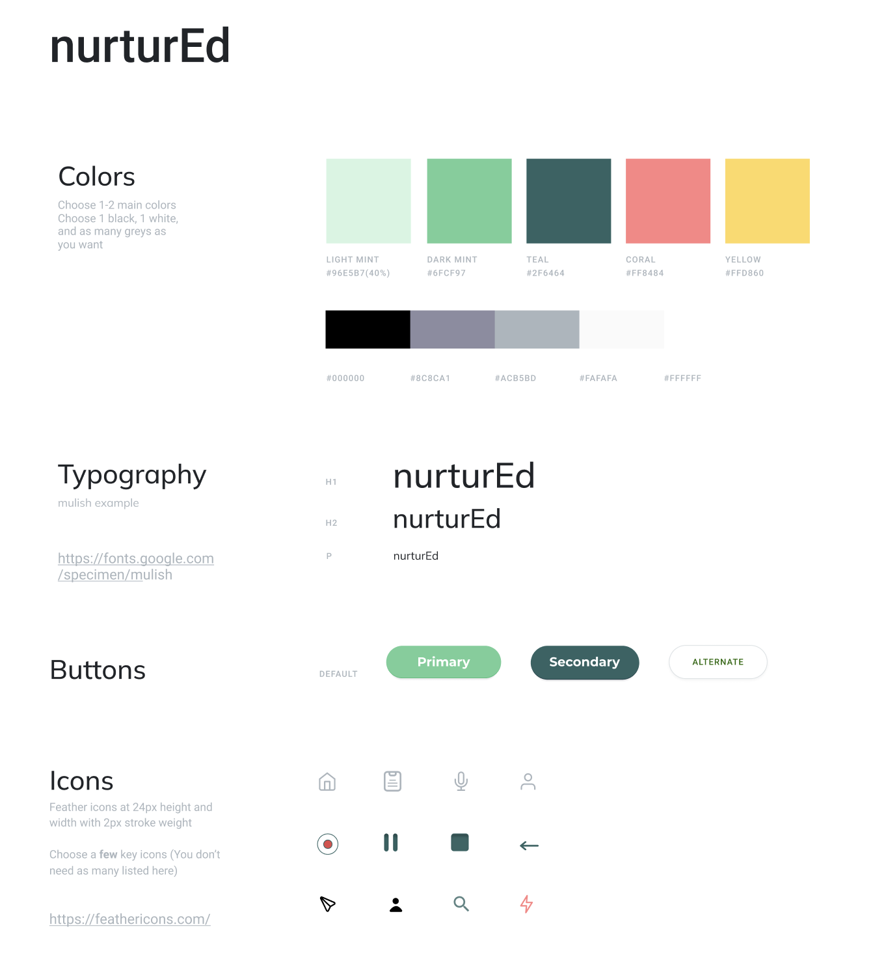
nurturEd
In line with this theme of nurturing growth, the colors we chose were:
Mint
Green
Teal
Coral (accent)
Yellow (accent)

Slide 16
Major Design Changes

Slide 17
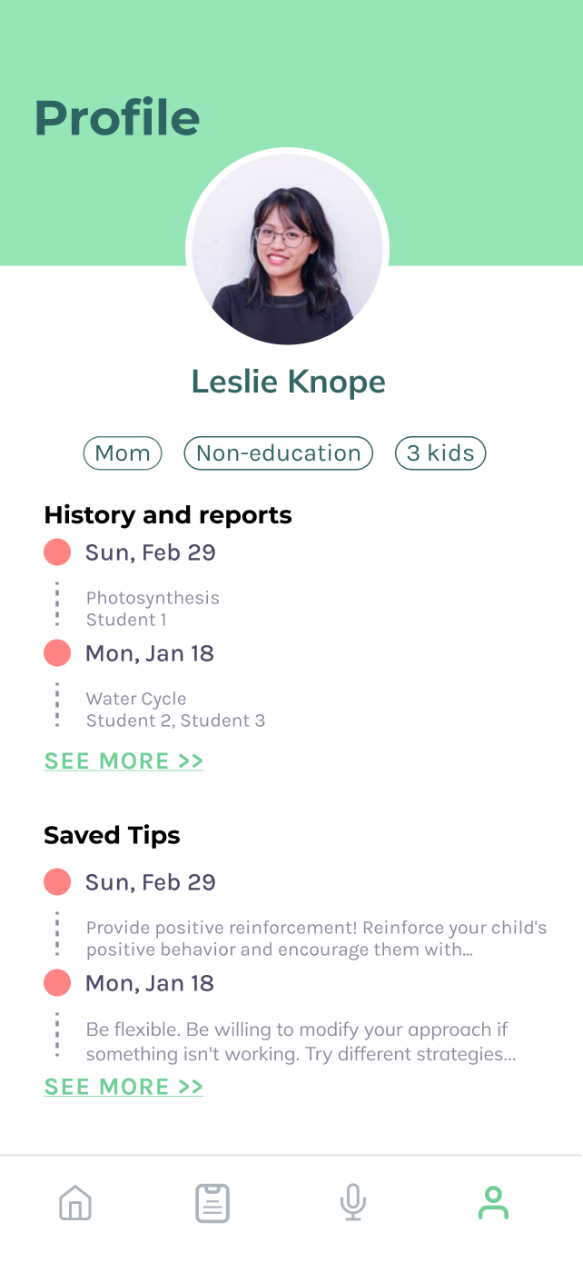
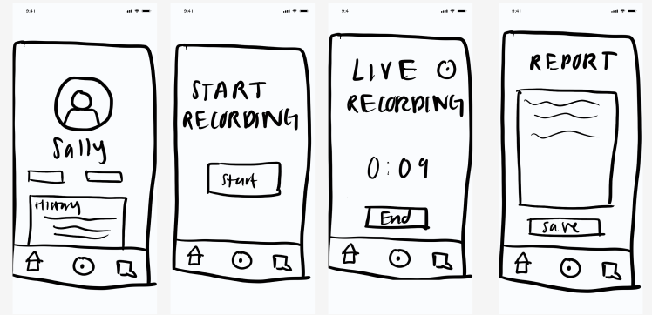
Navigation Bar Update
P4: “A little confused about chat icon”
P1: “what is this [button] and how can I use it”
Changes:
Focused on important features
Intuitive icons

Slide 18
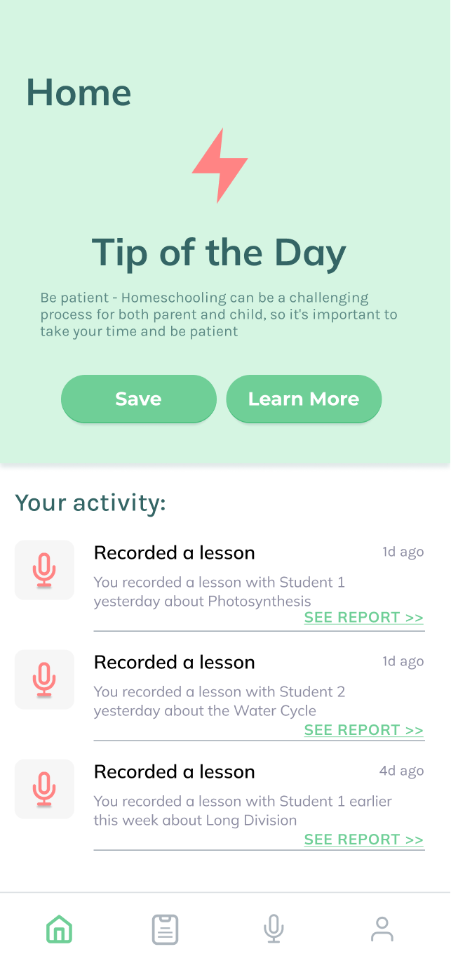
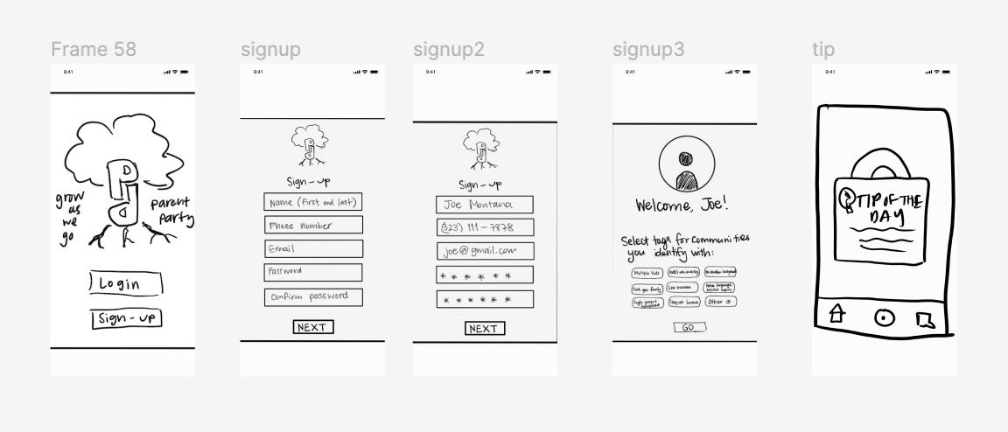
Tip of the Day
P1: “I want to learn more about the tip of day”
P4: *Tried to click record before clicking out of tip*
Changes:
Lasting tip, not pop up
Added ways to interact: Save, Learn More, saved tips

Slide 19
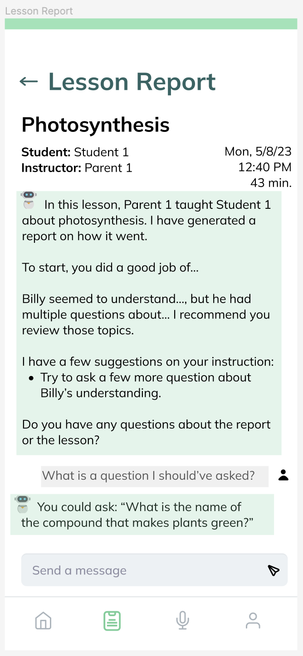
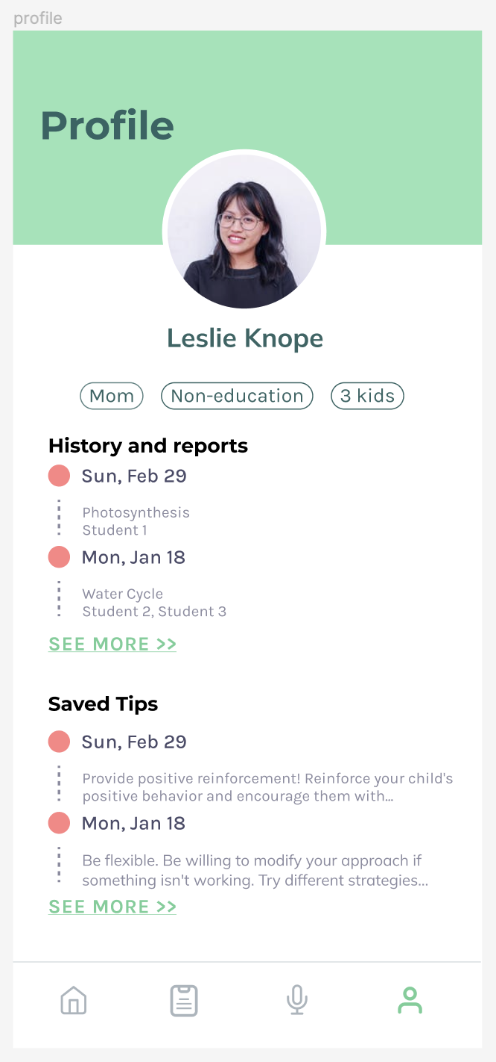
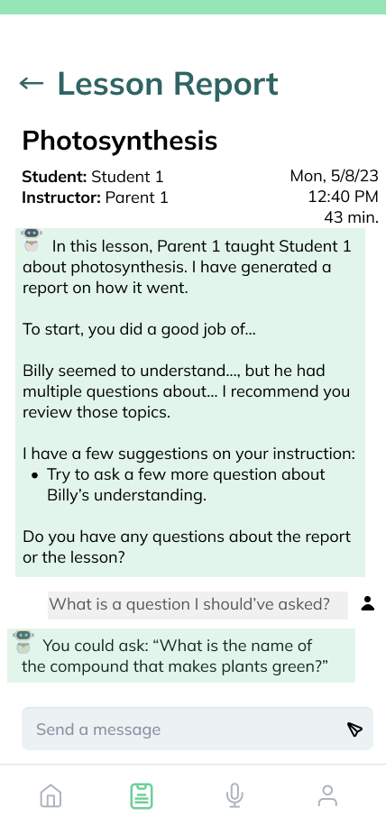
Lesson Report
P3: “I wish I could ask the AI, ‘What would you tell them?’”
P4: “...[the report] could give more examples”
Changes:
More interactive, parents can ask questions
Ensure that there is both positive and negative feedback

Slide 20
Med-fi Prototype

Slide 21
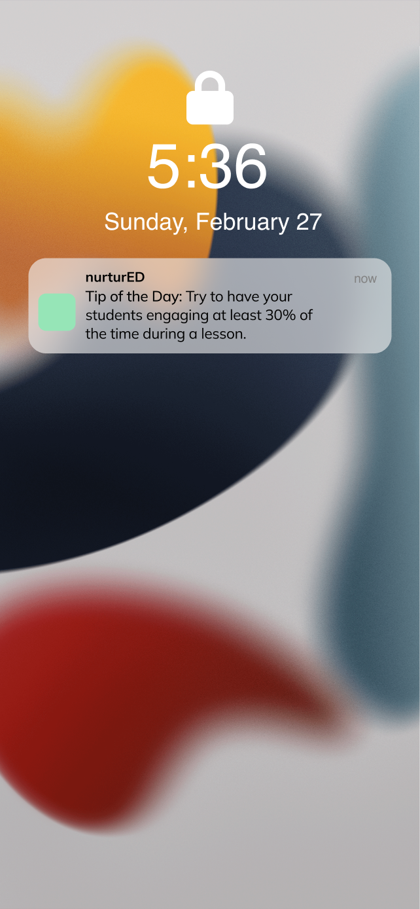
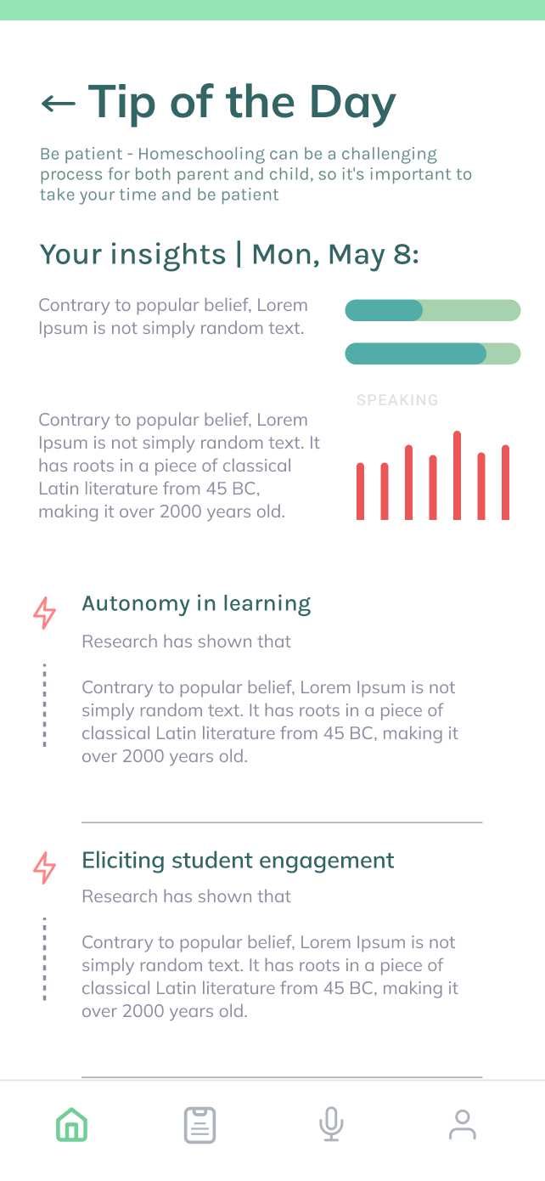
Simple Task: Access tip of the day
Flow 1: from notification + home screen

Slide 22
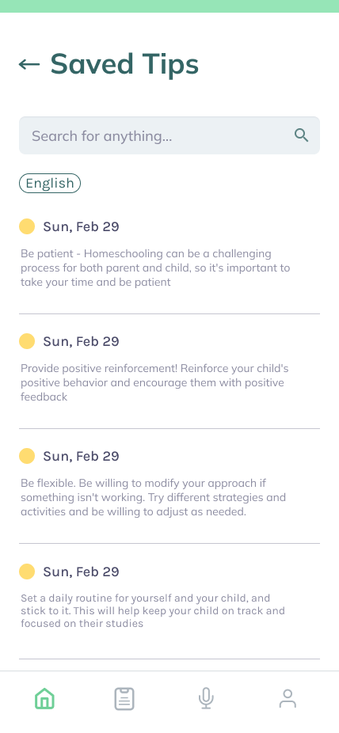
Simple Task: Access tip of the day
Flow 2: from profile + saved tips

Slide 23
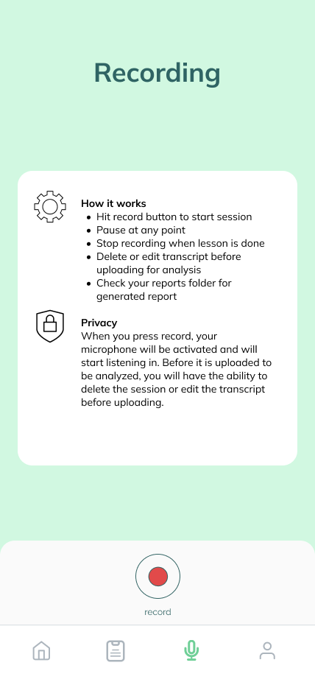
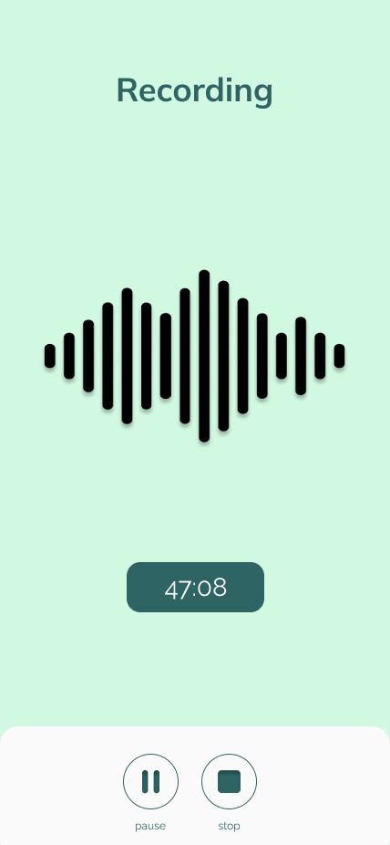
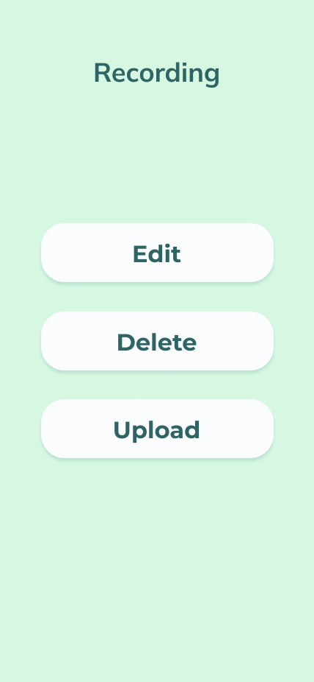
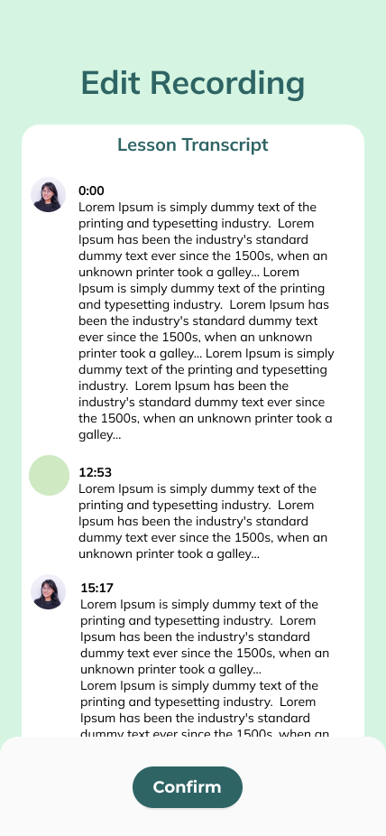
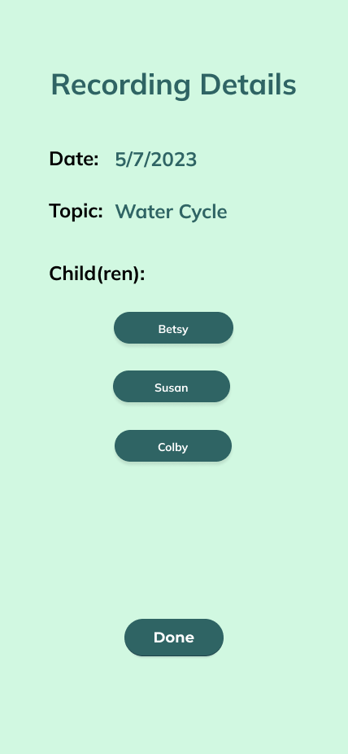
Moderate Task: Record a live lesson

Slide 24
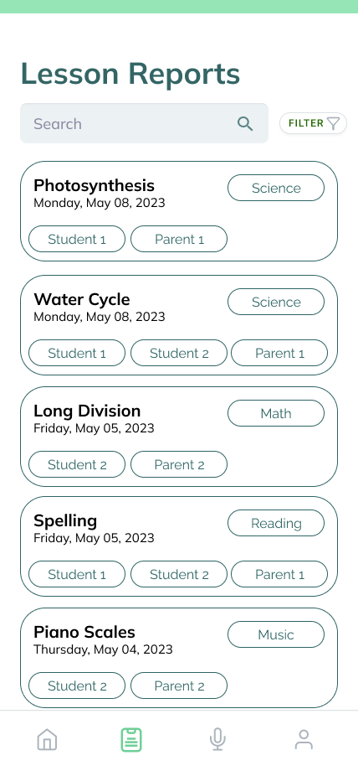
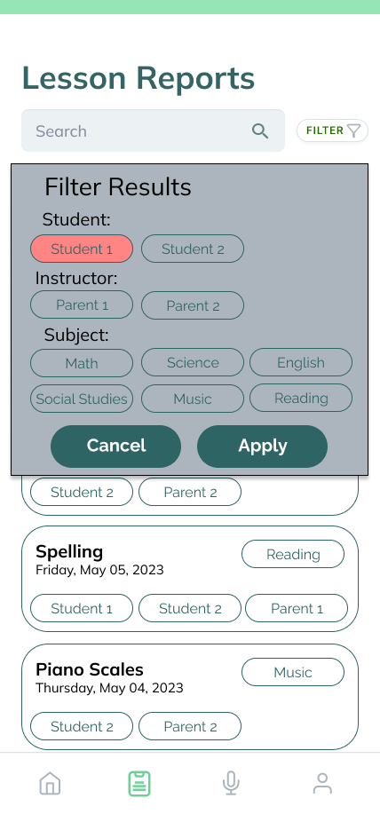
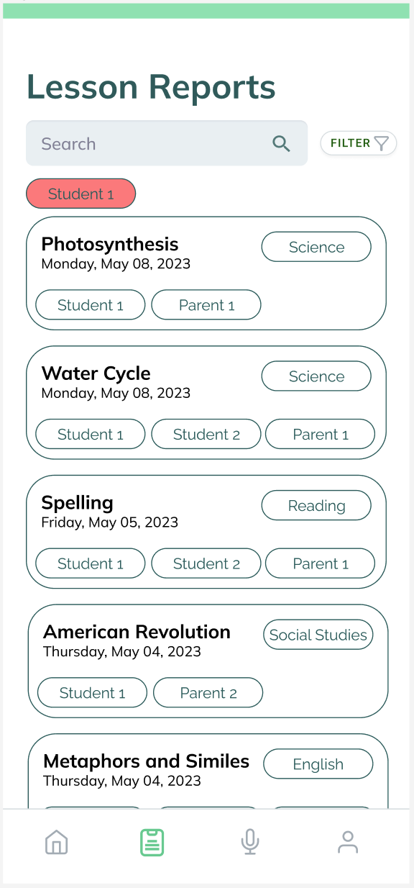
Complex Task: Analyze a previous report

Slide 25
Prototype Overview

Slide 26



PROS
Prototype mockup
Customizing design
Clickable prototype
Easy to collaborate
Creating content
Generating feedback
Free icons
CONS
Consistency was sometimes difficult
Broken links
Content needs editing
Difficult to find some icons
TOOLS

Slide 27
Limitations
Trade offs
No real AI interaction
Interviewer-generated feedback using AI
No child feedback included
Difficult to test real usage
Will the users who most need feedback help actually opt to use this app?
Removed practice sessions
Some parents may have used
Mobile vs web
Difficult to fully engage with quantity of information
Flexibility of recording on-the-go
Text heavy screens
Quantity and importance of information
Notes:
Pro of feedback: the idea of live recording such that parents wouldn’t have an extra burden of spending time
Con of parent party: dependent on other users for content, risky

Slide 28

Wizard of Oz
Simple Task
Tips and learn more are hard coded, not generated
Saving doesn’t actually update the server
Moderate Task
Recording will be done by interviewer, not in the prototype
Edit/Delete/Upload doesn’t actually do anything on a server
Complex Task
Question/interaction with AI agent has been hardcoded
We would provide a response to a question that a parent asks (not connected to ChatGPT or other LLM)
Search feature, filter - no backend to do real data segmenting

Slide 29
Thank you!
Questions? Feedback?

Slide 30
Summary
nurtured
With nurtured, we want to help parents nurture their students – supporting growth every step of the way.
Green for growth!
Tasks:
Simple: Access tip of the day
Moderate: Record a live lesson
Complex: Analyze your report
Changed complex task based on feedback from interviews

Slide 31
Appendix

Slide 32
Med-Fi Prototype Link
https://www.figma.com/file/oCOuGJZPxVFXkWoMFWCuvR/CS377E?type=design&node-id=284-23742

Slide 33
Med-fi Prototype Iteration /
Other Screens

Slide 34
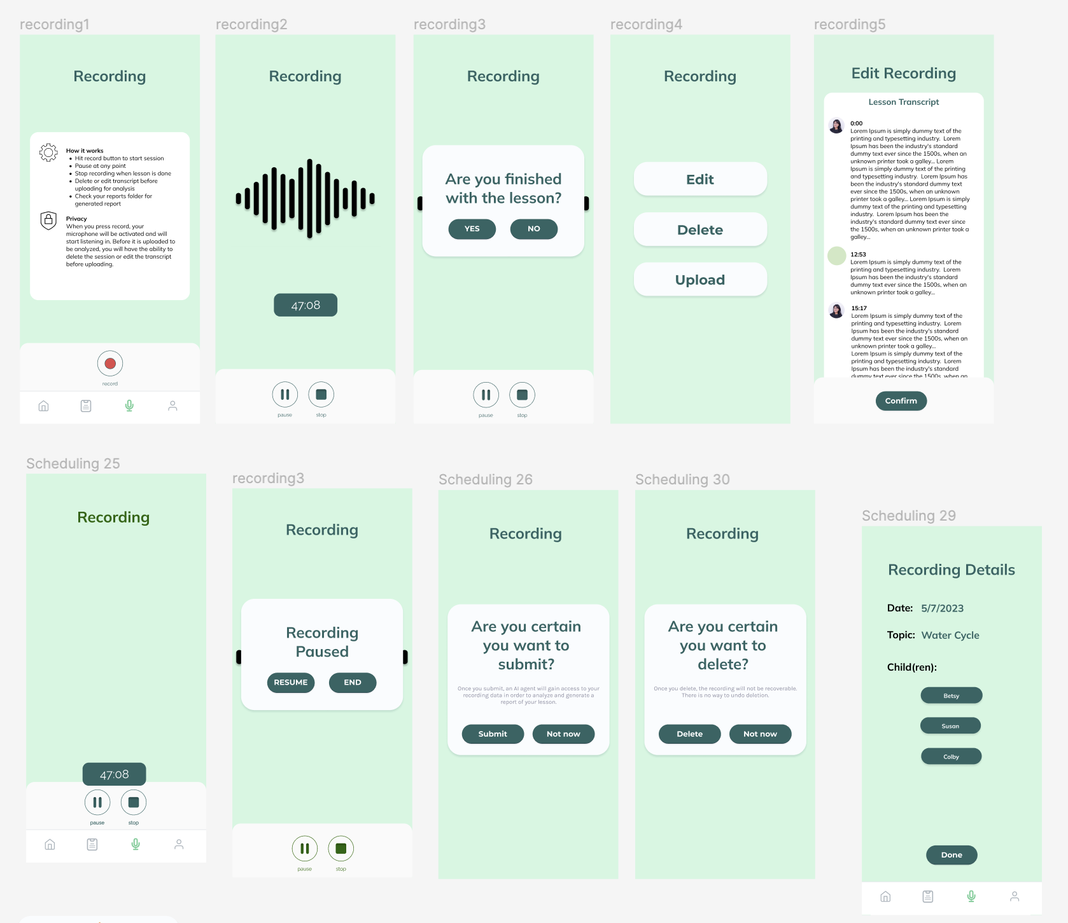
Moderate Task: Record a live lesson

Slide 35
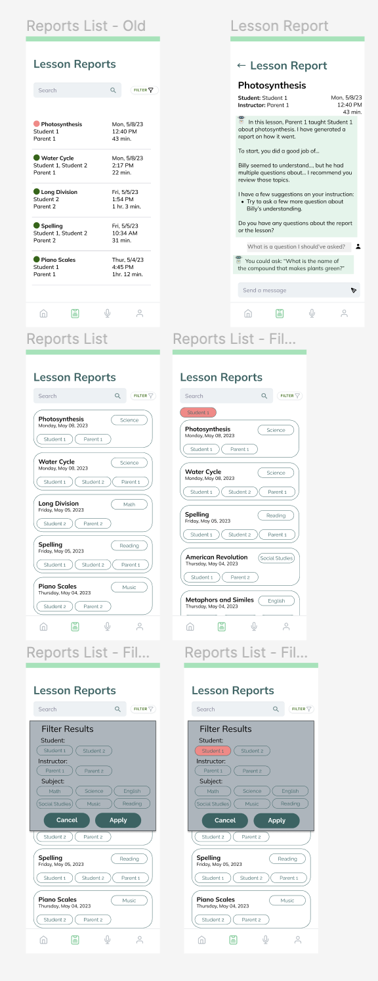
Complex Task: Analyze lesson report

Slide 36
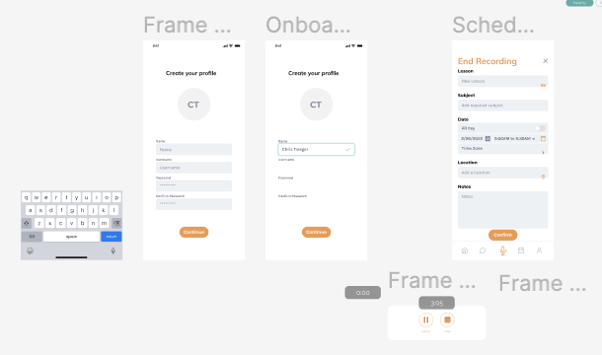
Onboarding

Slide 37
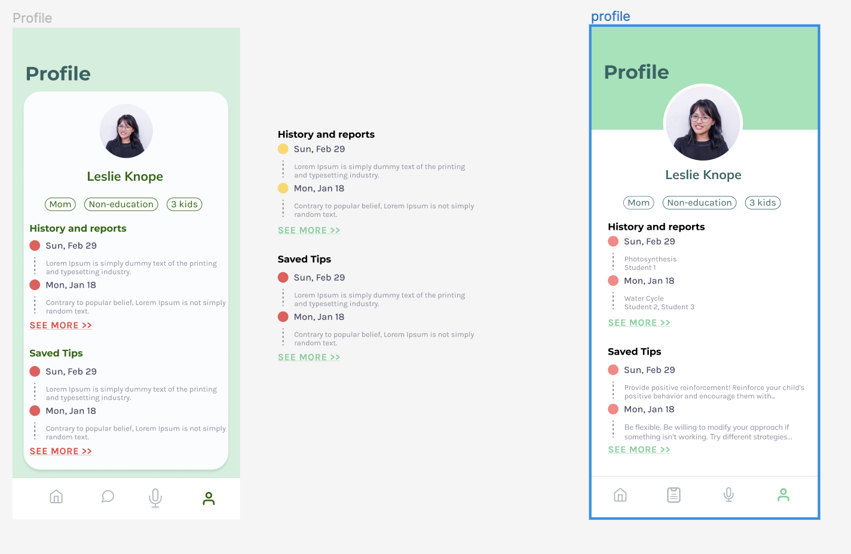
User Profile

Slide 38
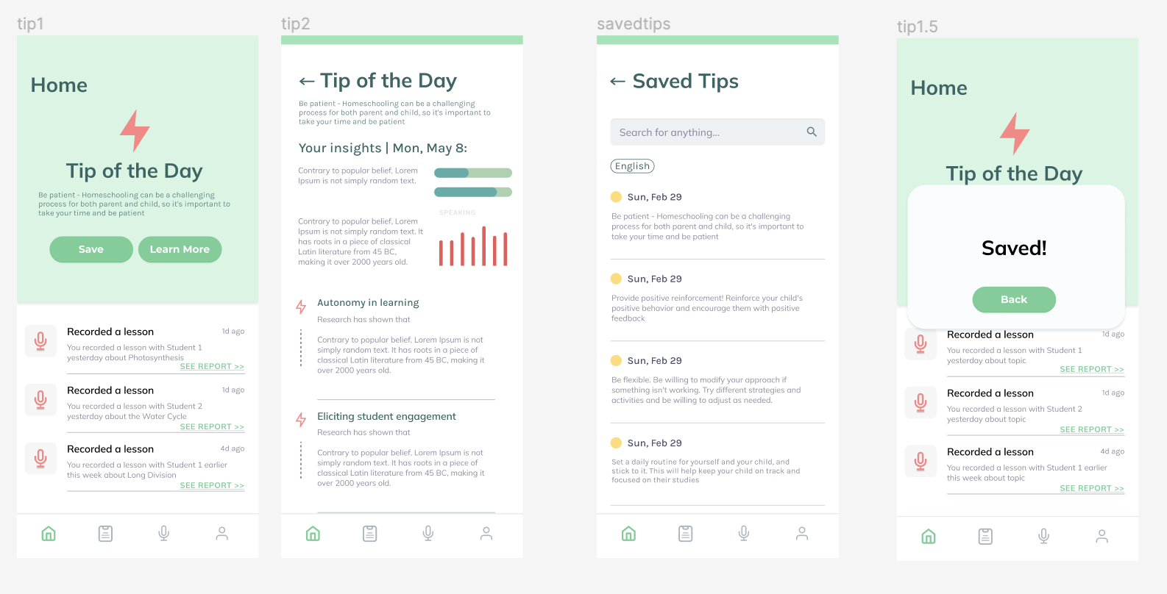
Tip of the Day

Slide 39
Low-fi Prototype

Slide 40
1: Tip of the Day (simple)

Slide 41
2: Live Recording (moderate)
JOE

Slide 42
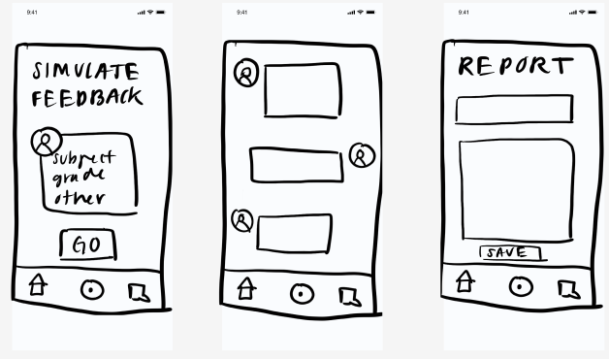
3: Feedback Simulator (complex)
JOE

Slide 43
Low-Fi Results
Simulation took too long
Concerns about privacy with recording
Parents appreciated having a consolidated resource – would like as much streamlining as possible
Liked live use case - can take it on the go
Audio recording does not capture visual aid use
Having examples of “good” teaching and feedback would be nice

Slide 44
Low-Fi Key Insights
Time is a key resource: no time for the simulation
Privacy concerns: ability to edit input before sending
AI is non-threatening: no pressure of judgment
Student feedback matters: include them in the process
Reports help parents to take the time to reflect
Proxy for expensive Teacher Ed programs
Building confidence leads to self-efficacy
“(as a homeschooling parent) Your life is very integrated. It’s go go go. You don’t often take time to sit, pause, and look back at what you did. This encourages and forces looking back.” – P1

